Slide 1













Introduction to Serverless
Understanding the Fundamentals of Serverless Computing
Event-Driven
No Server Management
Pay-as-you-go

Slide 2











What is Serverless?
Serverless computing is an application development and execution model where a cloud provider dynamically manages the server infrastructure required to run applications. It abstracts away the operational burden of provisioning, scaling, and maintaining servers, allowing developers to focus entirely on writing code.
Event-Driven Model
No Server Management
Functions execute in response to specific events, such as HTTP requests, database changes, or file uploads.
Developers are freed from provisioning, scaling, and maintaining servers.
Automatic Scaling
Pay-for-Value
Applications automatically scale based on demand, creating instances as needed.
Users pay only for the actual compute resources consumed during execution.

Slide 3






















How Serverless Works
Dormant
Trigger
Execute
Scale
Event-Driven Model
Function Execution
Functions remain dormant until a specific event occurs, such as an HTTP request, database change, or file upload.
Upon being triggered, the cloud provider dynamically provisions the necessary compute resources to execute the function.
Automatic Scaling
Pay-for-Value Billing
As demand increases, the platform automatically scales by creating more instances of the function. Resources are scaled down when demand decreases.
Users are charged only for the actual compute resources consumed during the execution of their code, eliminating costs for idle resources.

Slide 4



















Key Benefits of Serverless
Serverless computing delivers significant advantages for both businesses and developers, transforming how applications are built and deployed.
Cost Efficiency
Zero Server Management
Automatic Scaling
Pay only for actual resource consumption during code execution, eliminating costs for idle servers or over-provisioning.
Applications automatically scale based on demand, ensuring consistent performance without manual intervention.
Offload server provisioning, patching, and maintenance to the cloud provider, freeing up IT resources for other priorities.
Faster Time-to-Market
Reduced Operational Overhead
Focus on Core Logic
Deploy code more quickly, accelerating development cycles and enabling businesses to respond faster to market changes.
Abstract infrastructure, allowing developers to dedicate more time to solving business problems and optimizing application functionality.
Focus on writing application code and business logic rather than managing servers, leading to higher productivity.

Slide 5


















Popular Serverless Services
Key services from major cloud providers
AWS Services
Azure Services
Google Cloud Services
Lambda
Functions
Functions
Run code without provisioning servers
Run event-driven code without servers
Run code in response to events
API Gateway
Logic Apps
Cloud Run
Create REST APIs that integrate with AWS services
Integrate apps with prebuilt connectors
Run containerized apps without managing infrastructure
DynamoDB
NoSQL database with serverless options

Slide 6




















Use Cases for Serverless
Real-time File Processing
Web Applications
IoT Backends
Automatically trigger processing workflows when files are uploaded to storage services, enabling instant transformation, compression, or analysis.
Build scalable web frontends with serverless backend APIs that automatically scale with traffic, eliminating the need for server management.
Process and analyze data from IoT devices at scale, handling the variable and bursty nature of IoT traffic efficiently.
Data Processing Pipelines
Event-Driven Microservices
Background Tasks
Create ETL and data transformation workflows that scale automatically with data volume, processing large datasets cost-effectively.
Implement microservices architectures where services communicate through events, enabling loose coupling and independent scaling.
Handle periodic cleanup, reporting, and maintenance tasks without dedicated server resources, paying only for execution time.

Slide 7


Slide 8



AWS Lambda Fundamentals
λ
Serverless Computing Explained
Learn the core concepts, benefits, and practical applications of AWS Lambda

Slide 9













What is AWS Lambda?
AWS Lambda is a serverless, event-driven compute service that enables you to run code without provisioning or managing servers.
Serverless
Event-Driven
No server provisioning or management required. AWS handles all infrastructure concerns.
Code executes in response to events like file uploads, HTTP requests, or database changes.
Automatic Scaling
Pay-per-use
Scales from zero to thousands of concurrent executions to meet demand automatically.
You only pay for the compute time consumed, measured in milliseconds, and the number of requests.

Slide 10



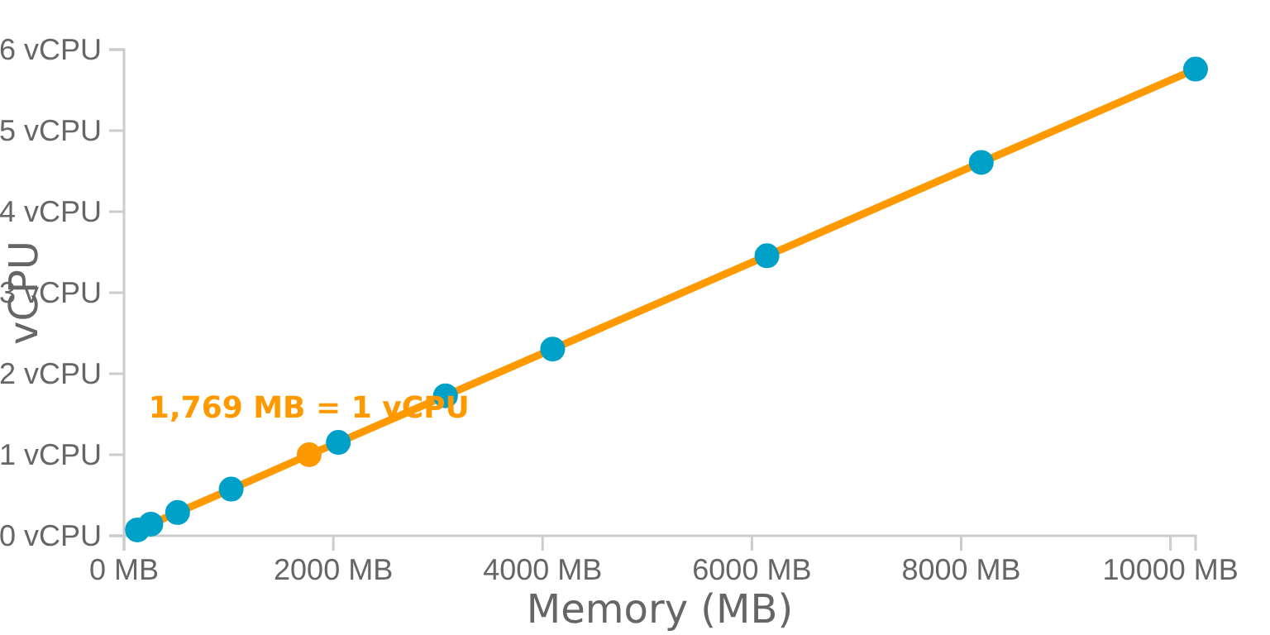








Memory (RAM) & CPU Allocation
Memory Allocation
Memory to CPU Relationship
Functions can be configured with memory between 128 MB and 10,240 MB (10 GB) in 1 MB increments.
CPU Allocation
CPU power is allocated proportionally to the configured memory, with approximately 1,769 MB providing one vCPU.
Cost & Performance Optimization
Billing is based on GB-seconds
1,769 MB ≈ 1 vCPU
Increasing memory can reduce execution time
Optimize to just below 100ms boundary
Increasing memory generally increases CPU
10,240 MB provides approximately 5.8 vCPUs

Slide 11










Lambda Timeout
Maximum Execution Duration
AWS Lambda functions can execute for a maximum of 900 seconds (15 minutes) in a single invocation.
15 min
Configurable Timeout
The timeout value is configurable through various methods:
AWS Management Console
AWS CLI
Important Timeout Facts
AWS Serverless Application Model (SAM)
Timeout applies to the Invoke phase of function execution
Other lifecycle phases (Init, Shutdown) have their own specific limits
Purpose of Timeout
Setting appropriate timeouts helps optimize costs and performance
Prevents functions from running indefinitely, consuming resources and incurring unexpected costs.

Slide 12

















Common Use Cases
Web & Mobile Backends
Data Processing
Scheduled Tasks
Processing tasks triggered by data events.
Automating routine operational tasks.
Serverless web backends using API Gateway, Lambda, and DynamoDB.
Database backups
Image resizing
Report generation
RESTful APIs
File format conversion
System health checks
Microservices
Log analysis
Single-page applications
Automatically scales to meet demand
Processes files as they arrive in S3
Using Amazon EventBridge

Slide 13













Execution Environment
Lambda functions run within a secure, isolated execution environment managed entirely by AWS. This environment provides the necessary processes and resources for your function to operate.
Execution Environment
Runtime
A secure, isolated environment that provides processes and resources for your function to operate. AWS provisions a new environment for each function invocation.
A language-specific environment (e.g., Node.js, Python, Java) that facilitates communication between Lambda and your function, relaying event information and responses.
Cold vs. Warm Starts
Cold Start
Normal Execution
Warm Start
First invocation or after idle timeout. AWS provisions a new execution environment, leading to increased latency.
Function is already initialized. AWS reuses the existing execution environment for improved performance.
Subsequent invocations reuse the existing execution environment, leading to reduced latency and improved performance.

Slide 14

















How Lambda Works
AWS Lambda operates on an event-driven architecture, executing code only in response to specific events. This model allows for highly scalable and efficient execution of functions.
5. Resources Released
1. Event Occurs
2. Trigger Activates
3. Function Executes
4. Response Generated
AWS manages resources; execution environment may be kept warm or terminated
Action takes place in AWS service or external application
Event source detects event and invokes configured Lambda function
Lambda provisions environment, downloads code, and runs handler
Function completes task and returns response to invoking service
Example: When a new image is uploaded to an S3 bucket, it triggers a Lambda function that resizes the image for different devices.

Slide 15


















Core Benefits of AWS Lambda
AWS Lambda offers several significant advantages that make it a compelling choice for serverless computing
Automatic Scaling
Pay-per-use Pricing
Reduced Operational Overhead
Functions automatically scale from zero to thousands of concurrent executions to meet demand without manual intervention.
You only pay for the compute time consumed, measured in milliseconds, and the number of requests, with no charges for idle resources.
AWS handles all infrastructure management, including server and operating system maintenance, capacity provisioning, and logging.
Multi-Language Support
Integration with AWS services
Free Tier
Lambda supports various programming languages like Python, Node.js, Java, Go, Ruby, .NET, and custom runtimes for flexible development.
Lambda seamlessly integrates with over 200 AWS services, enabling the creation of complex, event-driven architectures.
Access 1 million free requests per month and generous compute time allowances, enabling testing and small-scale production without costs.

Slide 16














Language Support
AWS Lambda offers broad support for various programming languages, providing flexibility for developers.
Node.js
Python
Java
JavaScript runtime for building scalable network applications. Great for APIs and microservices.
Popular language with rich ecosystem. Excellent for data processing, AI/ML, and automation.
Statically typed language ideal for large-scale applications. Strong performance and reliability.
C#
Go
Ruby
Language developed by Microsoft. Great for .NET applications and Windows integration.
Compiled language known for simplicity and efficiency. Excellent for microservices and cloud functions.
Dynamic language focused on simplicity and productivity. Good for rapid development and prototyping.

Slide 17












Functions and Handlers
Lambda Functions
How Functions and Handlers Work Together
Self-contained pieces of code that execute in response to specific events. They are the basic building blocks for creating serverless applications.
Handlers
The entry point for your code, designated to process event data. Only one method in a Lambda function can be marked as the handler.
Trigger
Function
Resource
def lambda_handler(event, context):
# Handler processes event data
bucket_name = event['Records'][0]['s3']['bucket']['name']
object_key = event['Records'][0]['s3']['object']['key']
# Process the data...
return "Success"
Event Data
Information about the trigger that caused the function to execute, containing details relevant to the event (e.g., bucket name, object key for S3 events).

Slide 18















Event-Driven Model
AWS Lambda's power stems from its event-driven architecture, which supports two primary invocation models:
Push Model
Pull Model
Direct Invocation: AWS services directly invoke Lambda functions by pushing events to them.
Event Source Mappings: Lambda actively polls services for new data.
Function triggered immediately when a specified event occurs
Lambda configures an event source mapping to read from a stream or queue
Examples: S3 object creation, API Gateway HTTP requests, SNS messages
Batches records and invokes the function with these batched events
Ideal for real-time processing of discrete events
Services: Amazon Kinesis, DynamoDB Streams, Amazon SQS
AWS Service
Event Source

Slide 19












Permissions and Roles
AWS Lambda functions require execution roles with IAM permissions to interact with other AWS services and resources.
Execution Roles
Every Lambda function requires an execution role that defines its permissions.
IAM Role
Principle of Least Privilege
CloudWatch Logs:PutLogEvents
Functions should only have access to resources and actions they explicitly need.
DynamoDB:GetItem
Common Permissions
CloudWatch Logs access for logging
DynamoDB access for data operations
S3 access for object storage

Slide 20








Deployment Packages
ZIP File Archives
Container Images
Up to 50 MB compressed
Up to 10 GB
Up to 250 MB unzipped
Self-contained with OS configuration
Suitable for interpreted languages
Uploaded to Amazon ECR
Best For:
Best For:
Functions with fewer dependencies
Functions with complex dependencies
Python, Node.js, and other interpreted languages
Large codebases
Simple deployment packages
Specific OS configurations
0 MB
50 MB (ZIP)
250 MB
10 GB (Container)

Slide 21











Common Triggers and Integrations
AWS services that can trigger Lambda functions
Amazon S3
API Gateway
Triggers functions on object creation, deletion, or updates in S3 buckets.
Responds to HTTP/HTTPS requests and triggers functions for RESTful APIs.
DynamoDB
SNS
Triggers functions on table items' creation, modification, or deletion.
Publishes messages to topics that can trigger Lambda functions.
Other Event Sources
CloudWatch Events
CodeCommit
Kinesis

Slide 22


Slide 23






Question 1
What is the primary characteristic of AWS Lambda that eliminates the need for server management?
A
It provides dedicated EC2 instances for each function.
B
It automatically provisions and manages the underlying infrastructure.
C
It requires manual scaling of server fleets.
D
It uses Docker containers that users manage.

Slide 24





Correct Answer: B
It automatically provisions and manages the underlying infrastructure.
Explanation:
AWS Lambda is a serverless compute service, meaning it automatically provisions, scales, and manages the infrastructure required to run your code. Users only need to upload their code, and Lambda handles all the operational aspects of running and scaling it, eliminating the need for server management.
Key Point: Serverless computing abstracts away server management, allowing developers to focus on code rather than infrastructure.

Slide 25




Question 2
What is the maximum execution time for a single AWS Lambda function invocation?
A
5 minutes
B
10 minutes
C
15 minutes
D
30 minutes

Slide 26








Correct Answer: C. 15 minutes
A key limitation of AWS Lambda is its maximum execution time. A single Lambda function invocation can run for a maximum of 15 minutes (900 seconds). If a function exceeds this limit, it is forcefully terminated by AWS.
15
minutes
Key Points to Remember
The maximum execution time is configurable up to 15 minutes
Maximum execution time
Functions exceeding this limit are terminated without warning
across all AWS Lambda runtimes
Design functions to complete within the time limit for reliability

Slide 27





Question 3
What is a "cold start" in the context of AWS Lambda?
A
The time it takes for a function to connect to a database.
B
The latency experienced when a new execution environment is initialized for a function.
C
The delay caused by network congestion.
D
The time required to download the function code from S3.

Slide 28









Correct Answer: B
The latency experienced when a new execution environment is initialized for a function.
A "cold start" refers to the latency incurred when AWS Lambda needs to initialize a new execution environment for a function. This process involves:
Download Code
Start Runtime
Run Initialization
Lambda downloads the function code from storage
Initializes the runtime environment
Executes any initialization code
Note: Cold starts can add noticeable delay to the first invocation of a function. Subsequent invocations use the warmed-up execution environment, resulting in faster response times.

